Slide 1

JP Morgan Chase and Co.
Data Analysis: Sales Prospects from Home Mortgage Data

Slide 2
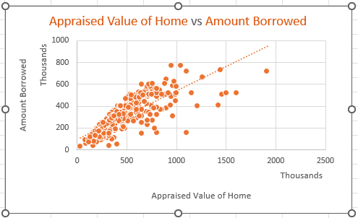

Home appraise value vs amount borrowed

Slide 3
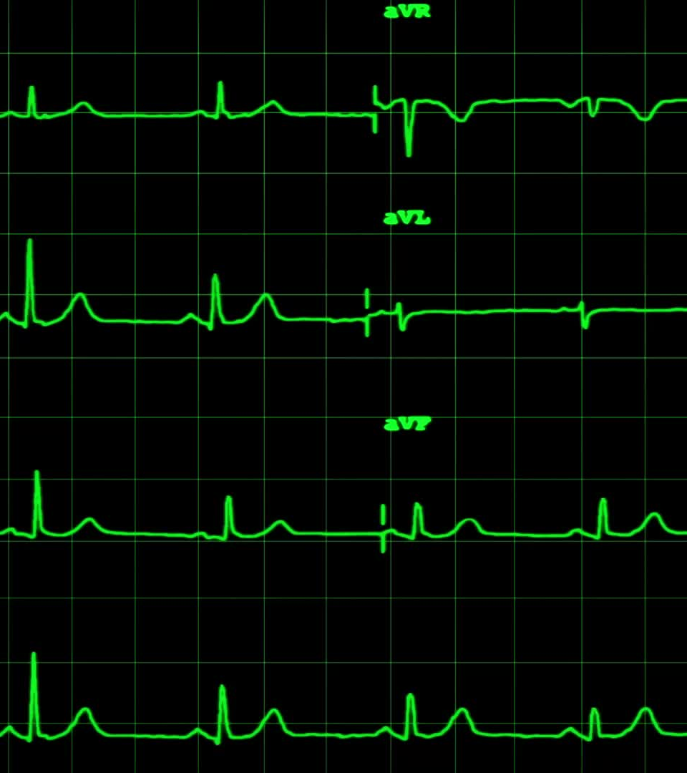
HOME APPRAISE VALUE VS BORROWED AMOUNT:
Scatter Plot Analysis:
This scatter plot displays the relationship between the appraised value of homes (x-axis) and the amount borrowed (y-axis).
Each dot represents a single loan, indicating its appraised home value and corresponding loan amount.
Key Observations:
Positive Correlation: The chart shows a strong positive correlation between the appraised value of the home and the amount borrowed.
Trend Line: The dotted trend line further emphasizes this correlation, indicating that as the appraised value increases, the amount borrowed also tends to increase.
Data Concentration: Most of the data points are concentrated below 1000 thousand (or 1 million) for both the appraised value and the amount borrowed, suggesting that higher-value homes are less common

Slide 4
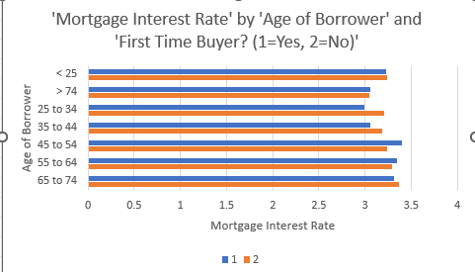
MORTGAGE INTEREST RATE BY AGE OF BORROWER & FIRST-TIME BUYER:

Slide 5

MORTGAGE INTEREST RATE BY AGE OF BORROWER & FIRST-TIME BUYER:
Generally, the interest rates fall between 3% and 3.5% for all age groups.
There’s a slight trend of higher interest rates for older borrowers, particularly for those over 74.
First-time buyers (represented by ‘1’) tend to have tend to have slightly higher interest rates as compared to non-first-time buyers across all age groups.
The difference in rates between first-time and non-first-time buyers is most pronounced in the younger age groups (< 25 and 25-34).

Slide 6

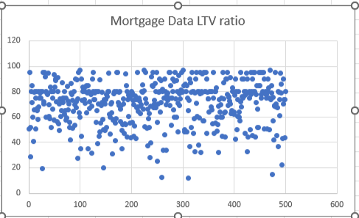
LOAN TO VALUE RATIOS:

Slide 7
LOAN TO VALUE RATIOS:
This scatter plot shows the Loan-to-Value (LTV) ratio for various mortgage data points.
The LTV ratios are mostly concentrated between 40% and 100%.
There's a dense cluster of data points around the 80% LTV mark, which is a common threshold for mortgage insurance requirements.
Some outliers exist with very low LTV ratios (below 20%) and a few above 100%.
The spread of data suggests a wide variety of mortgage situations, from low-risk (low LTV) to potentially high-risk (high LTV) loans.

Slide 8
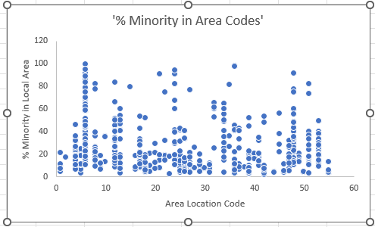
MINORITY % IN AREA CODE:

Slide 9
MINORITY % IN AREA CODE
Wide range of minority populations: The chart shows significant variation in minority percentages across area codes, ranging from near 0% to over 80%.
Clustering in mid-range: A dense cluster of data points appears in the 20-40% minority range, indicating this is a common demographic makeup for many areas.
Extreme cases present: Some areas show very high (80%+) or very low (near 0%) minority populations, highlighting the existence of both highly diverse and more homogeneous communities.
Varied spread within codes: Some area codes (e.g., around 5, 25, and 45) display a wider vertical spread, suggesting more demographic variability within these specific regions.

Slide 10

THANK YOU FOR YOUR ATTENTION!

